Slide 1
2025 Q1 Ocasnet Meeting

Slide 2

Please Scan the QR code for attendance

Slide 3
Agenda
Introduction All 2 Min
Site update/reminder from TSCA Lori 5 min
Event Score Card 2024
  Epoxy Scaffold finding Ray 5 min
  Scaffolding Egress Requirements Israel 5 Min
  Scaffolding Best Practises Bobby 5 Min
Procurement Path Forward Taylor Richards 15 Min
MOC Changes Chase 10 min
Upcoming Trainings Todd 5 min
Chlorine Institute update – ManHours Todd 5 Min
Leadership Corner Bill/Tim 10 Min
Contractor Survey Bobby 1 min
Conclusion

Slide 4
TSCA Reminder
Asbestos Standard under TSCA
Methylene Chloride
Silica Construction
Lori Zemen

Slide 5

TSCA Methylene Chloride
Olin Manufactures Methylene Chloride. Any contractor work in Olin Units where Methylene Chloride may present a potential exposure will need to follow the TSCA Methylene Chloride standard.
Initial monitoring due by May 5, 2025
Company responsibility, not Olin. If Over ECEL, Olin will work to help develop the WCPP

Slide 6
2024 Event scorecard Review

Slide 7
2024 Event Scorecard Site
Event reviews
3-12-24 | Sliding angle iron onto rack and finger caught between – broken finger
3-17-24 | Moving 150# valve by hand – Torn ligament/tendon in shoulder
5-6-24 | 600# roll of bags, tipped over landing on foot/ankle – Broke Foot
10-16-24 | Tighten bolt on compressor with wrench – Wrench Slipped – Chipped Tooth

Slide 8
Scaffold LER epoxy review

Slide 9
Audit Findings and Scaffold Construction

Slide 10
Osha Minimum Requirements
29 CFR 1910.36- Design and Construction Requirements for Exit Routes (g)(2)&(4)
(g) An exit route must meet minimum height and width requirements.
(2) An exit access must be at least 28 inches (71.1 cm) wide at all points. Where there is only one exit access leading to an exit or exit discharge, the width of the exit and exit discharge must be at least equal to the width of the exit access.
(4) Objects that project into the exit route must not reduce the width of the exit route to less than the minimum width requirements for exit routes.
Ray

Slide 11
Audit Findings
  Scaffolding erected was blocking exit paths where the width of the path was less that 15 inches in several places, not at least 28 inches as required, limiting the ability for personnel to access stairways on either side of the decks for the purpose of emergency egress.
  A portable fire extinguisher was blocked by scaffolding installed on the top deck.
  Tank R-600A which has a radioactive source attached presented impact risk with scaffolding and leftover debris in close proximity to the reactor.
Israel

Slide 12
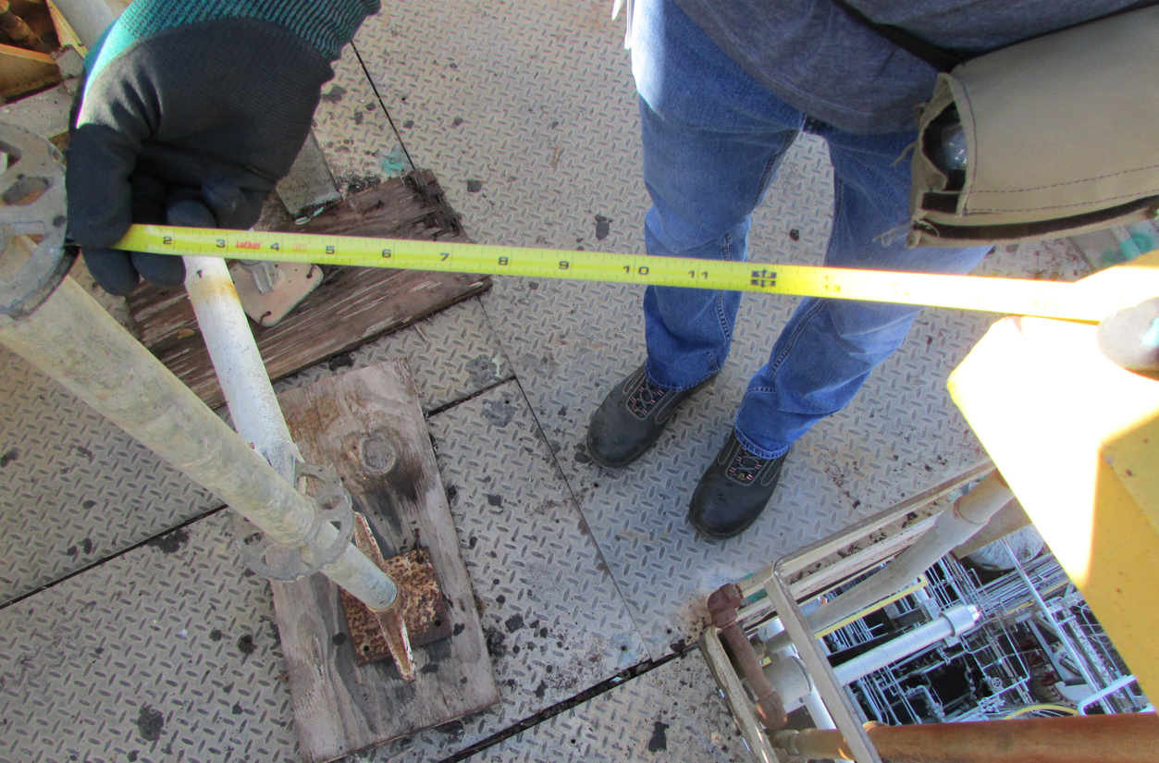
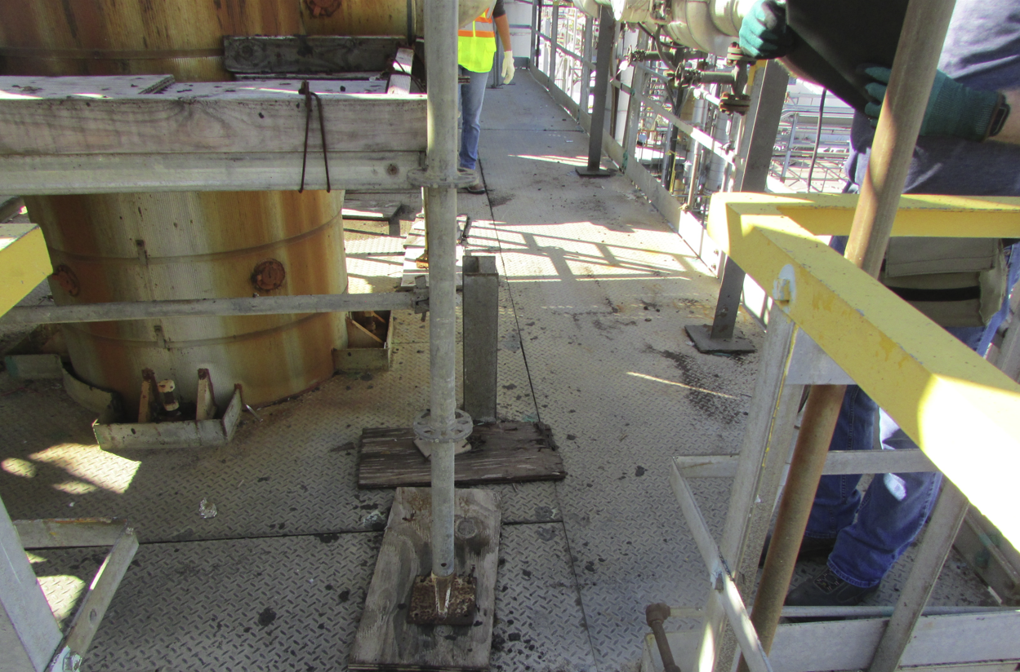
Pics
15” opening, not enough clearance.
Opening should be at least 28”.

Slide 13
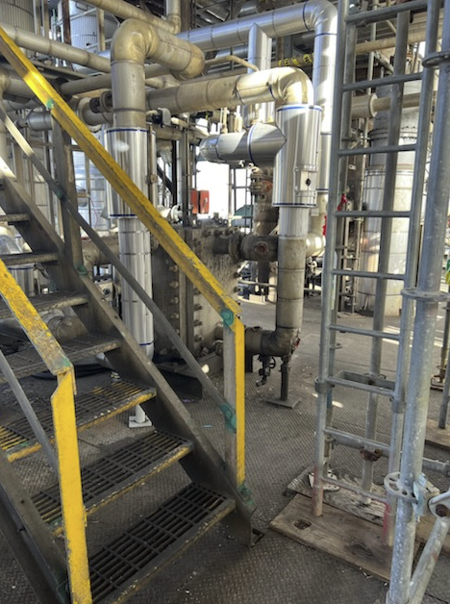
Pics
Opening should be at least 28”.

Slide 14
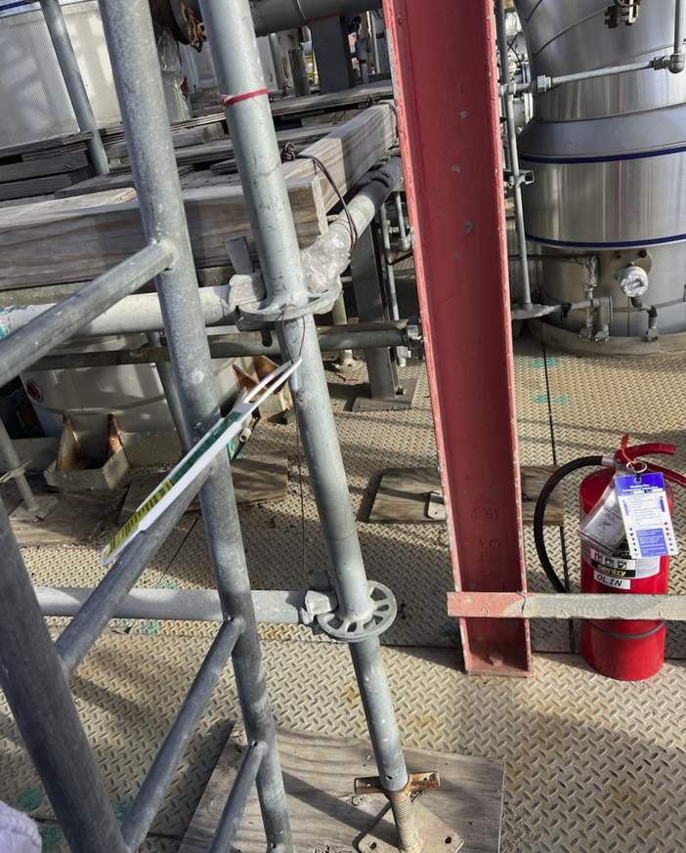
Pics
Scaffold blocked fire extinguisher from being hung.

Slide 15
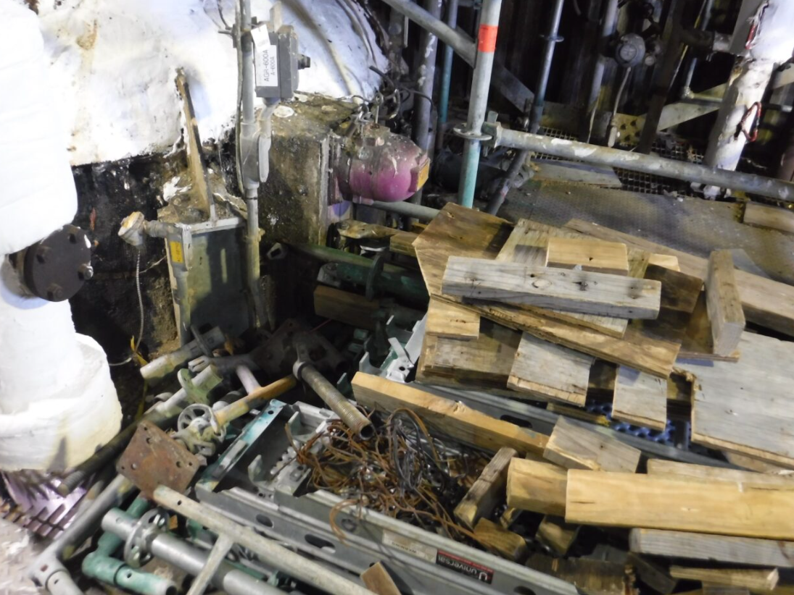
Pics
Scaffolding material near Radioactive Source.
Scaffold blocked fire extinguisher.

Slide 16
Scaffold Construction Design Considerations
We value safety over compliance; if it can be constructed more safely, it should be !!

Slide 17
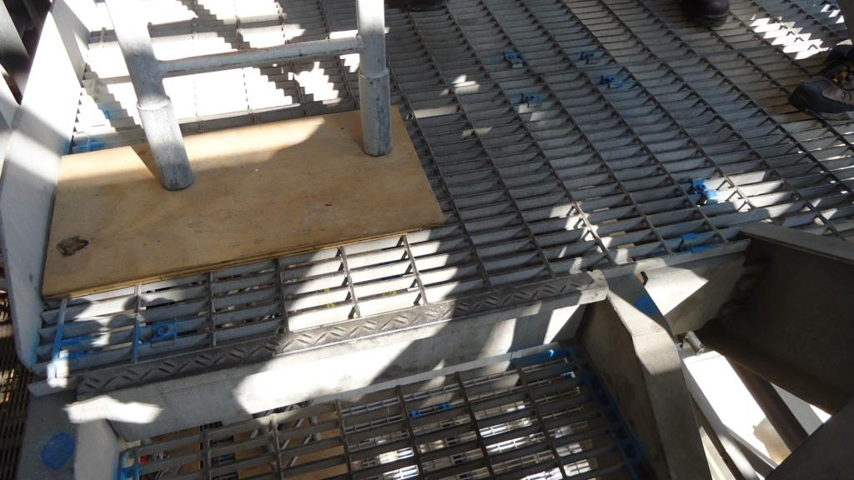
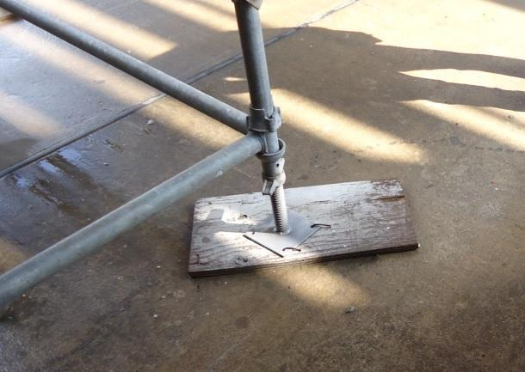
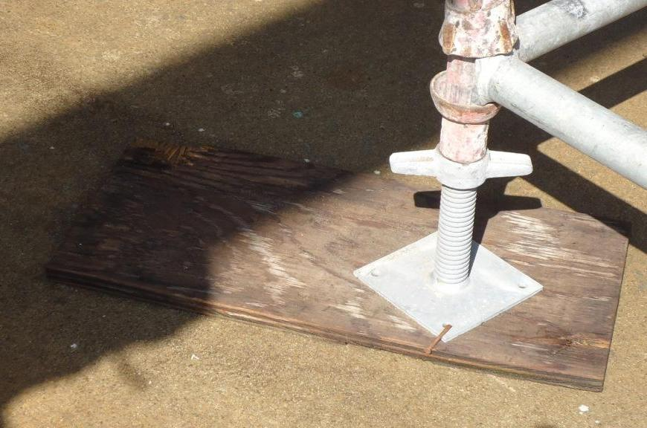
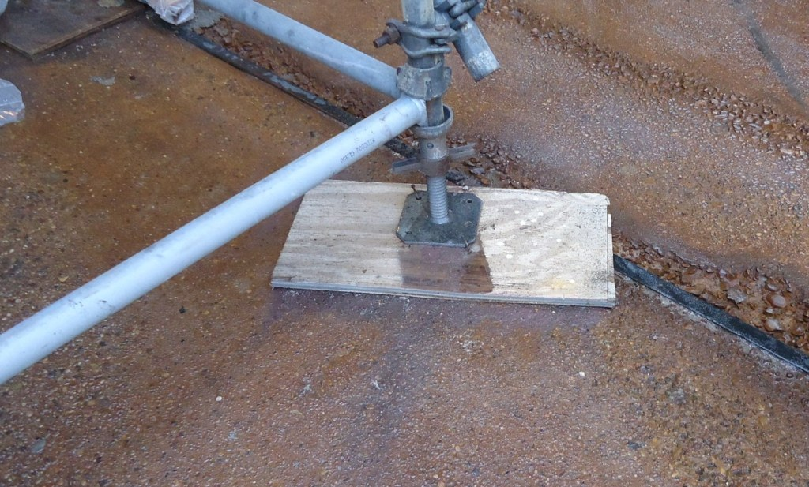
Best Practices Design – Minimize Mud Sills
(board footings) in Walkway
Undesired: Tripping hazard at to of stairs !
Undesired: Tripping hazard outside each of these corners
Bobby

Slide 18
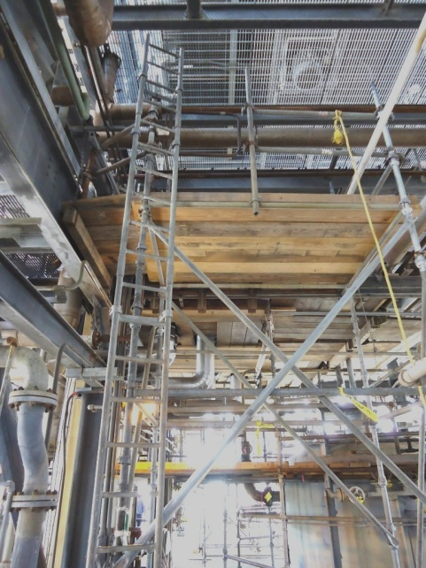
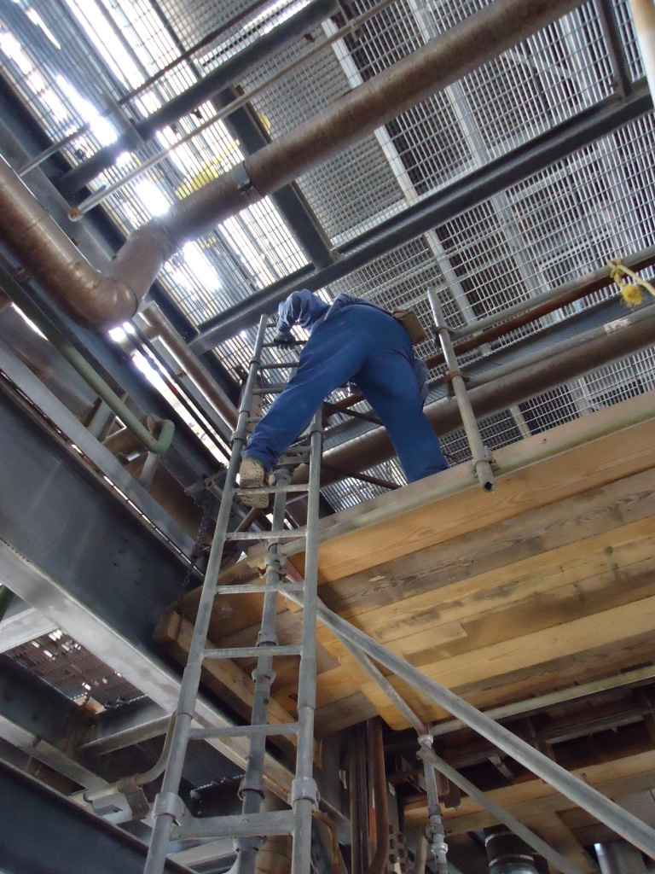
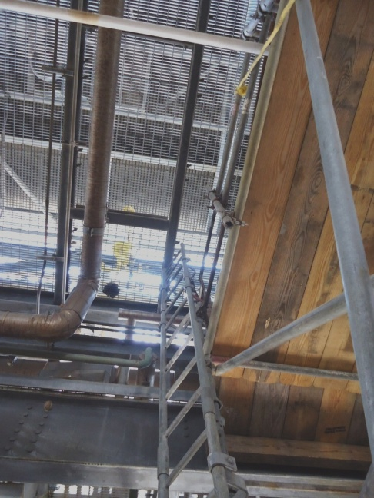
Ladder Access: (including single levels)
Undesired: Notice the effort required by this worker to step around the railing and to the far side of the gate.
The next slide shows the modification.
FAR SIDE ENTRANCE
STEP AROUND RAILING REQUIRED

Slide 19
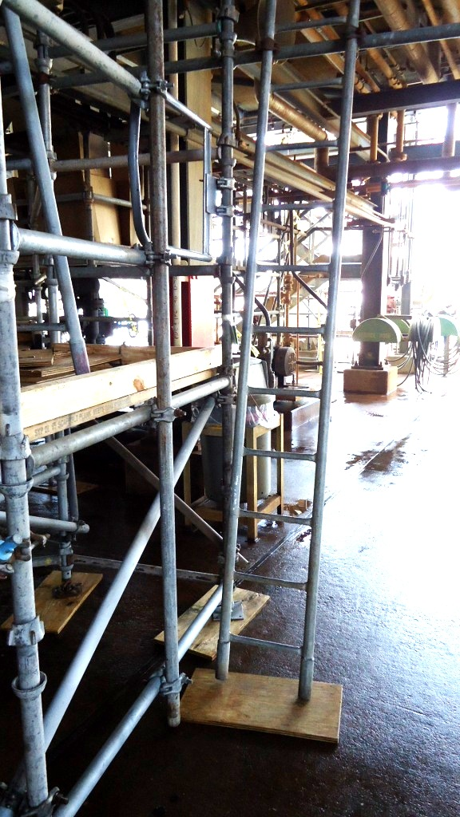
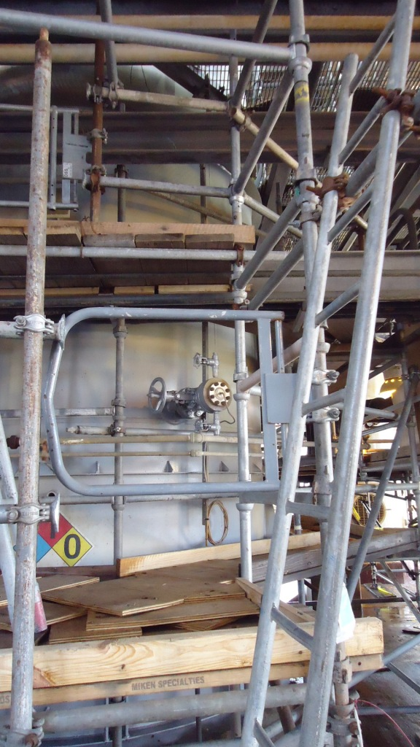
Ladder Access: Use 90° Design, Best Practice (including single levels)
Desired: Ladder is installed at 90° angle.
Much safer access through the swing gate!

Slide 20
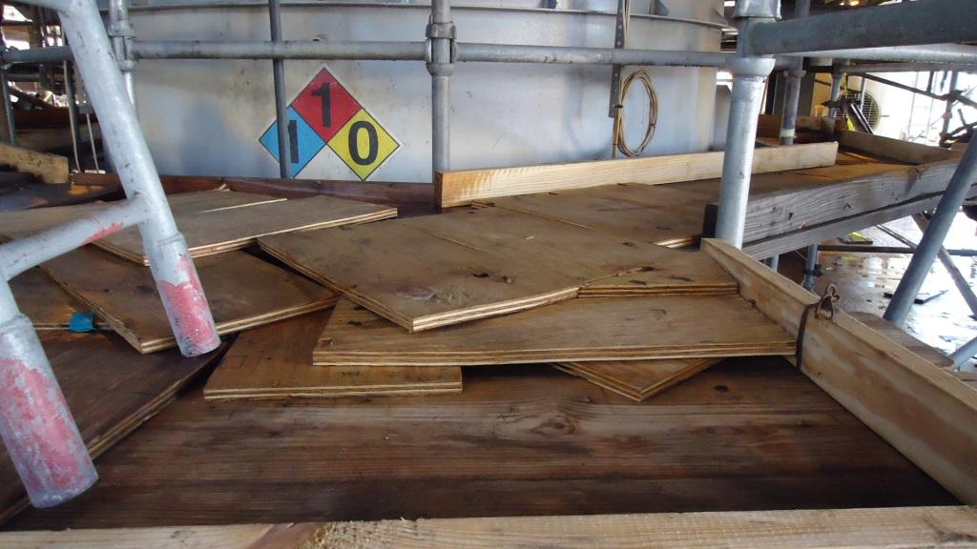
Design: Avoid (Minimize) Multiple Layers of Boarding on Walking Surfaces
Undesired: Significant tripping hazards as you step onto the platform from the stairs !
Note: Many times, a tarp will be placed over the boards (for hot work) & the tarp will hide these traps- We need help to avoid these traps !

Slide 21
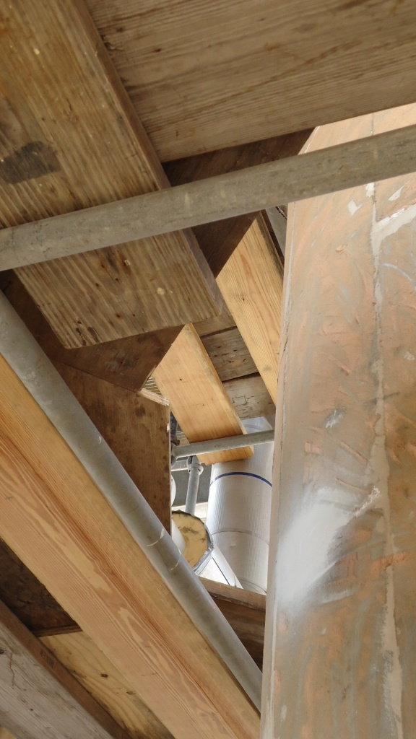
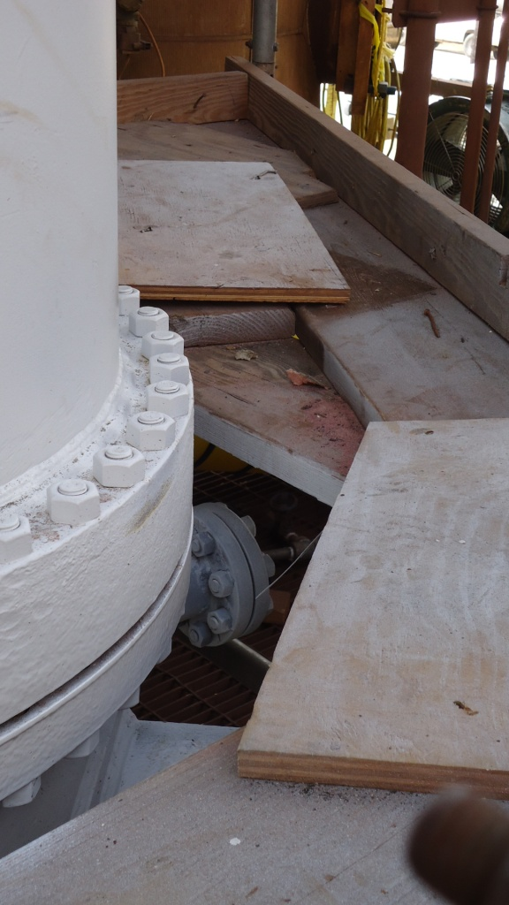
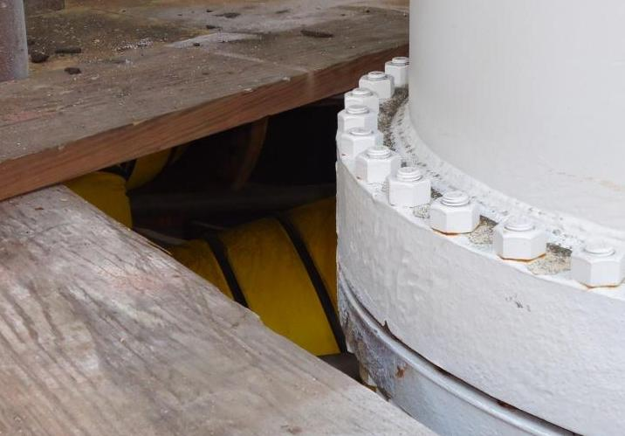
Possible Traps Avoid Gaps Between Equipment and Scaffold
Note: If gap is needed to apply insulation, remove only when insulation is being applied (toe board also needed)
Undesired: Gaps create tripping & falling hazards (people and materials) !
If gap exists, or if created by removing insulation, the scaffold tag should be pulled & treated as incomplete scaffold !

Slide 22
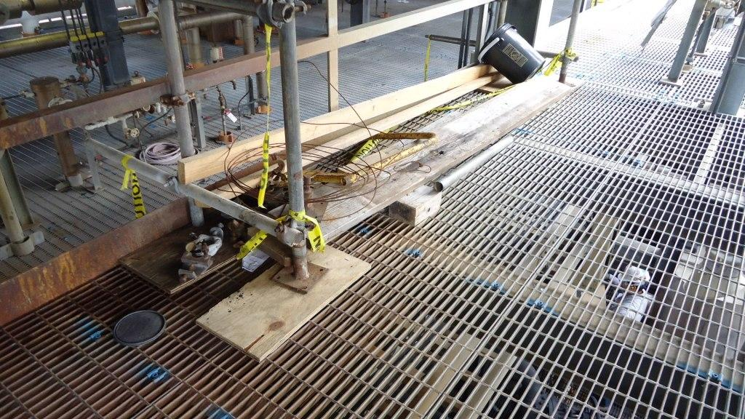
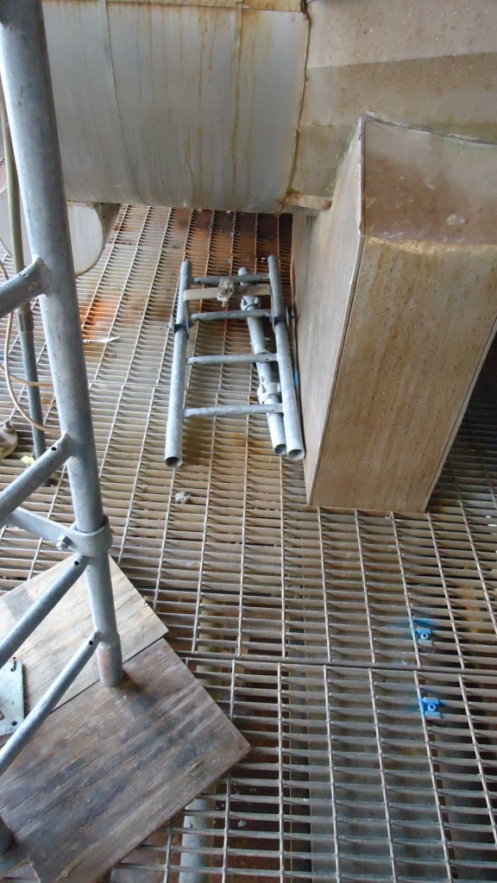
Good Housekeeping Practices: Clean-Up and Don’t Store Material in the Plant
Undesired: Any material placed in the plant creates additional safety issues. Not much housekeeping effort is required to eliminate these additional hazards.

Slide 23
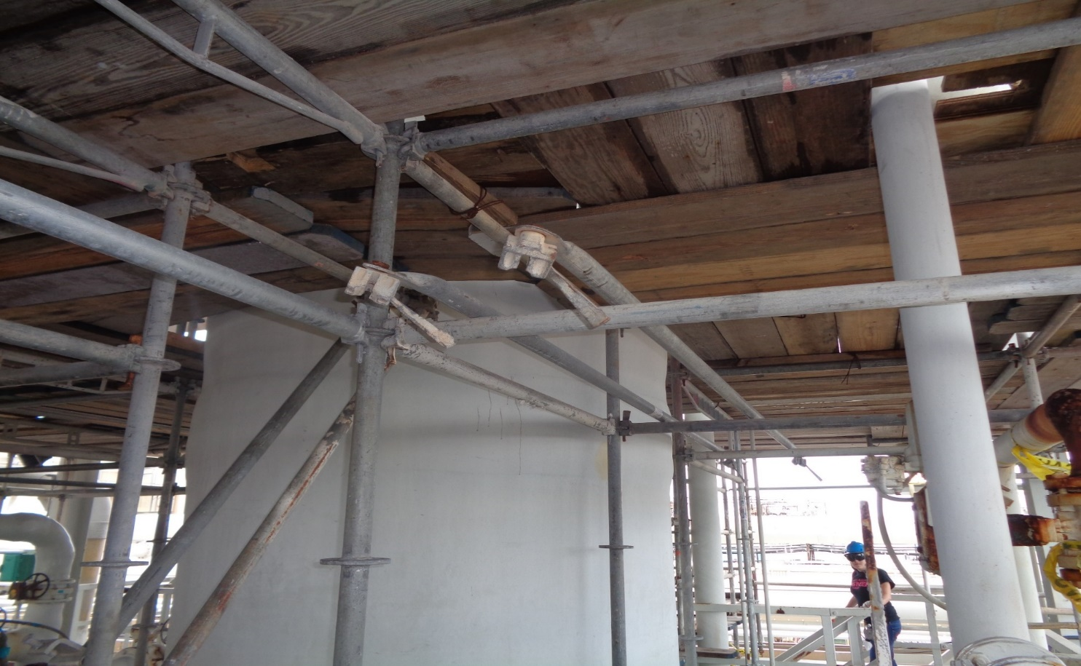
Housekeeping
Scaffold poles not attached to anything
OLIN RESTRICTED - For internal use only
Notes:
JAY: add title

Slide 24
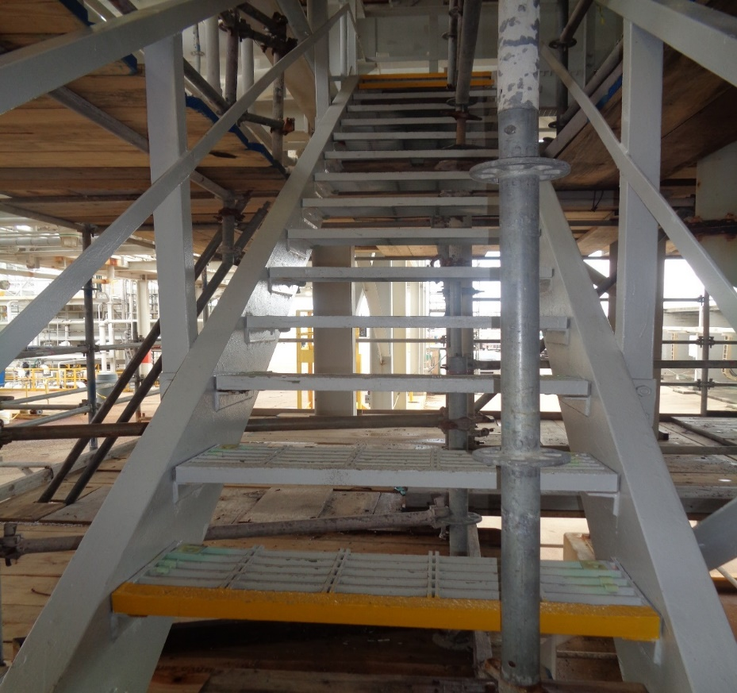
Scaffold Blocking & in Walkways…
Scaffold blocking stair access
OLIN RESTRICTED - For internal use only
Notes:
JAY: Add Title

Slide 25
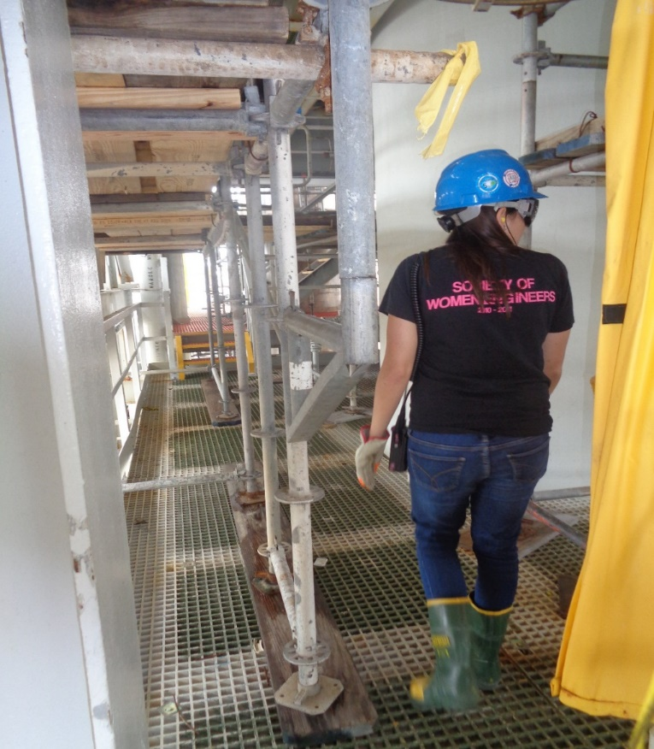
Scaffold Blocking & in Walkways…
Scaffold blocking access, sticking into walkway
OLIN RESTRICTED - For internal use only
Notes:
JAY: Add title

Slide 26
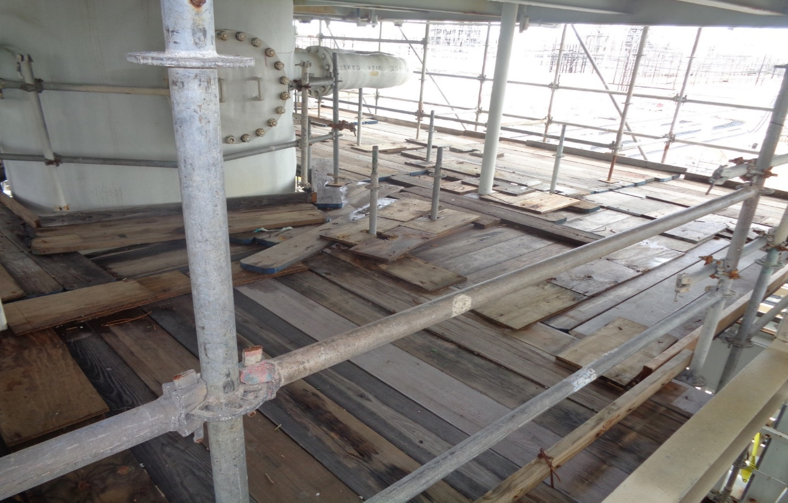
Scaffold Blocking & in Walkways…
Scaffold from lower deck sticking through next level
OLIN RESTRICTED - For internal use only
Notes:
JAY: Add Title

Slide 27
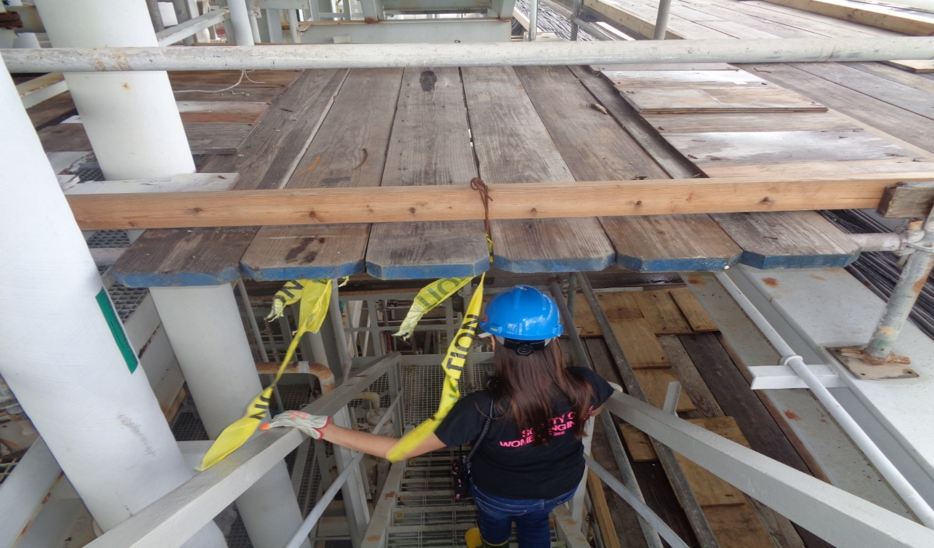
Best Practice Scaffold Blocking & in Walkways…
Head knocker always flag hazards
OLIN RESTRICTED - For internal use only
Notes:
JAY: Add Title

Slide 28
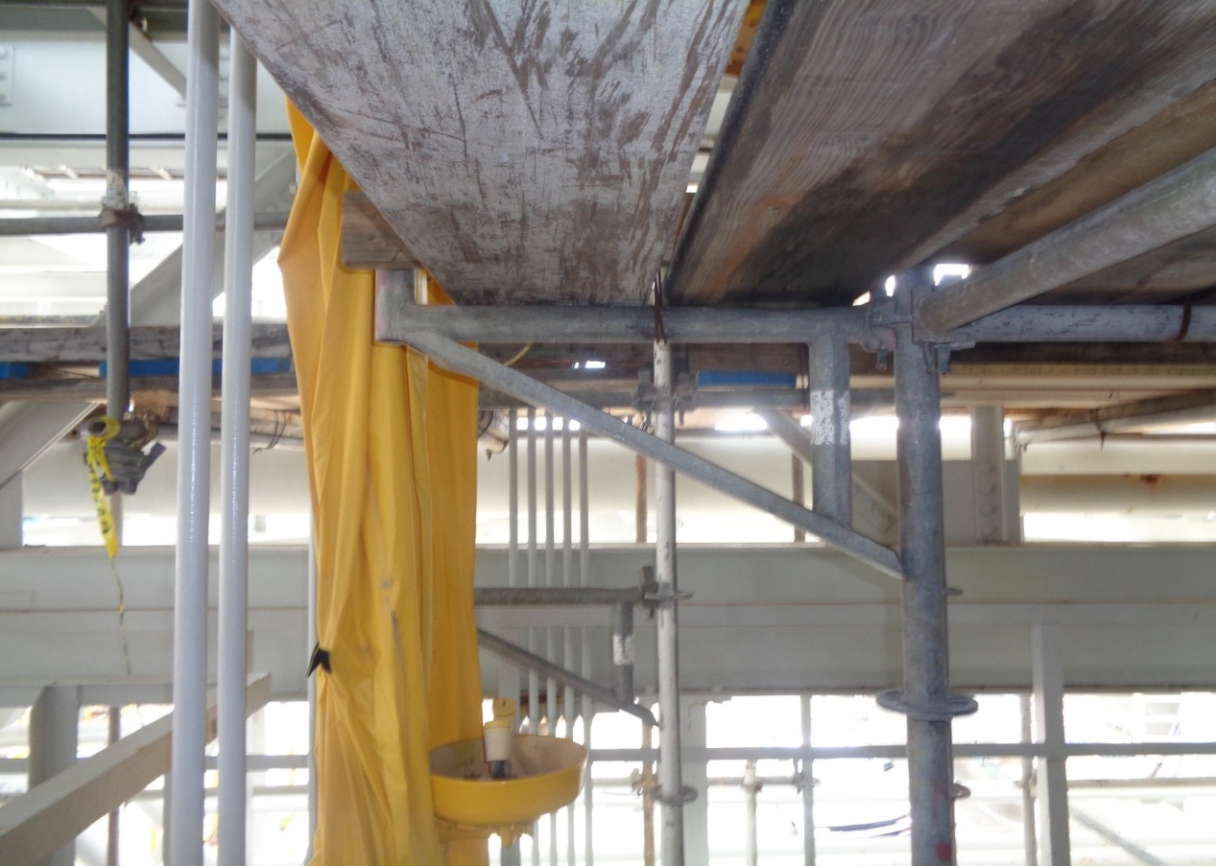
Blocking Emergency Shower
Scaffold deck is low hanging, blocking access to Safety Shower & Eye Bath
OLIN RESTRICTED - For internal use only
Notes:
JAY: Add Title

Slide 29
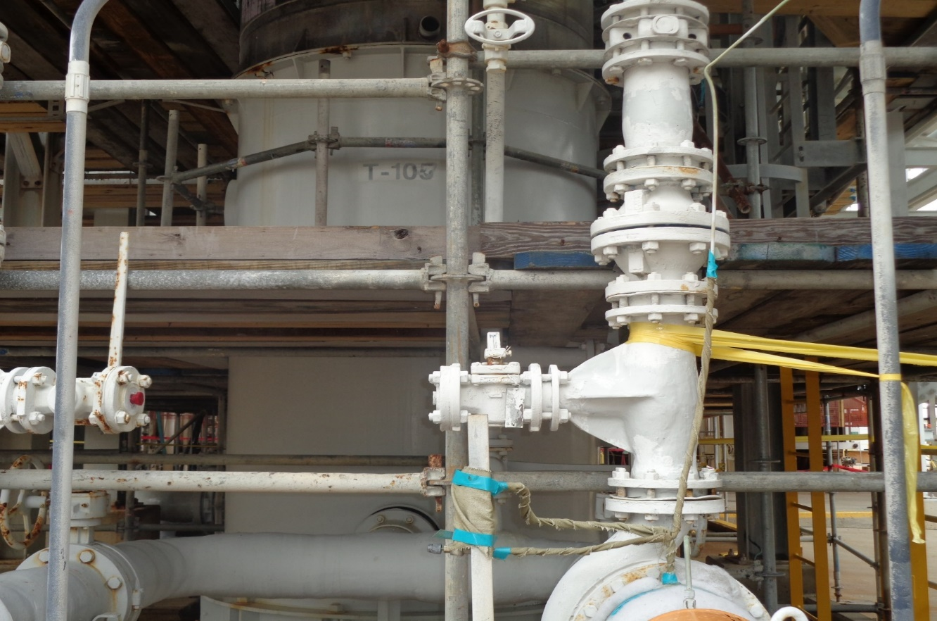
Scaffold Blocking & in Walkways…
Cannot open valve, scaffold pole is blocking
OLIN RESTRICTED - For internal use only
Notes:
JAY: Add Title

Slide 30
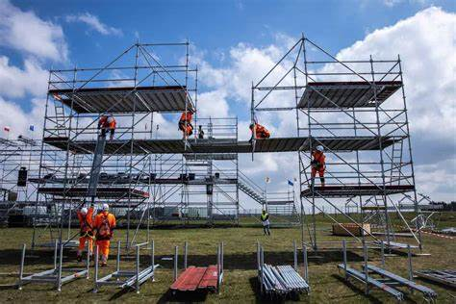
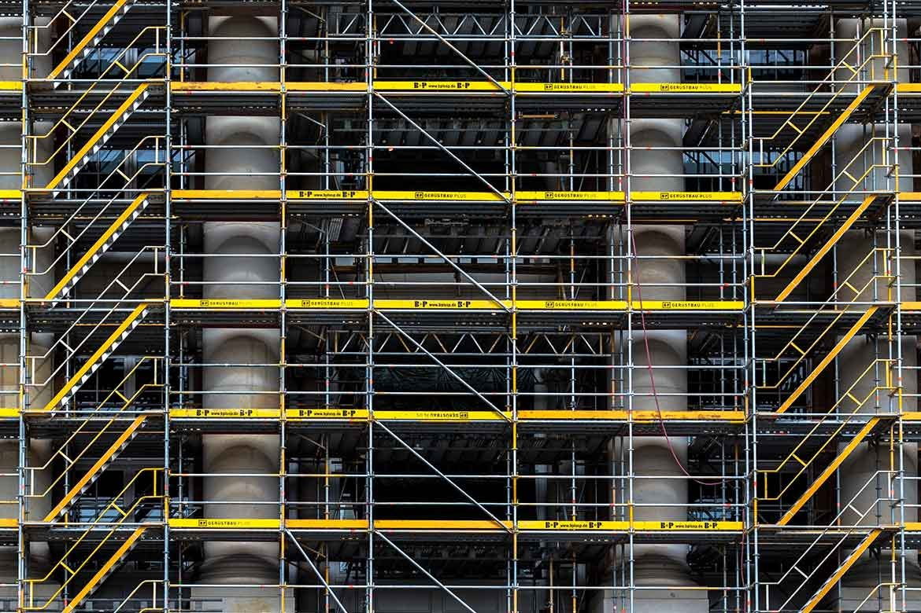
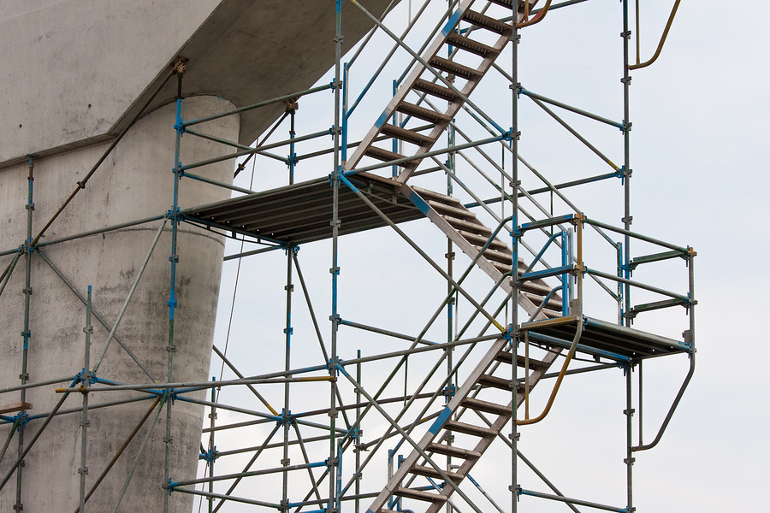
Scaffold Best Practice - Bobby

Slide 31
Procurement Path Forward

Slide 32
Taylor Richards
Safety – Targeting Zero
  Safety is not just a priority—it’s a core value. A safe worksite protects the workers.
  Proactive Planning: We require thorough risk assessments and safety plans before work begins. Hazard Recognition Plus (HRP) and identifying specific stop the job triggers are good examples.
  Culture of Accountability: Safety isn’t just the responsibility of leadership; it’s a shared commitment among all team members.
  A strong safety culture ensures everyone goes home safely just the way they came in.
Reliability & Performance
  Delivering on commitments—on time, within budget, and to the highest standards.
  Clear Communication: Regular status updates and transparent reporting keep everyone aligned.
  Skilled Workforce: Investing in training and certifications enhances workmanship.
  Lean Practices: Eliminating waste and optimizing workflows reduces rework and inefficiencies.
  Reliable teams build strong reputations and foster long-term relationships.
Cost
  Strategic planning, not sacrificing quality.
  Early Collaboration: Bringing cost-effective solutions upfront and getting alignment.
  Advanced Technologies: Tablet technology, real-time project tracking improve productivity and better ways of doing the job.
  Preventative Maintenance: Addressing minor issues early prevents expensive repairs later. Correctly performing disassembly, as found inspections, and assembly are key parts.
  The goal is to maximize value while maintaining safety and quality.
Conclusion
  In summary, they are all not separate goals—they work together to ensure success in the end. By prioritizing safety, maintaining reliability, driving high performance, and strategically managing costs, we create a win-win scenario for all stakeholders.

Slide 33
MOC Changes - updates

Slide 34
MOC Changes / Updates – Chase Blanchard
Here are some of the updates that have taken place:
  Freeport Radio Management
  Secure Access Control
    Freeport Badging Work Process
    Waiver Process
    Lock & Key Process
    Camera Process
    TAC Security
  PPE Grid Update for Epichlorohydrin
  Respiratory Protection change for Methylene Chloride

Slide 35
US FREE 24 02769 P, In Service 1/08/2025 Owner: Brian Blanchard
Freeport Radio Management
Scope: Freeport Site
Purpose:
An Olin Radio policy was created to ensure a consistent work process is followed across the TXO site. This work process will follow the guidelines currently in place lined out in the Olin/Dow site service agreements and Motorola requirements.
Basis:
The Basis for this Policy is to clarify requirements and work processes. This will align with expectations outlined in Dow/Olin site service agreements.
Clarifying the process and expectations will restrict unnecessary spending on site radios. This will also enforce all the necessary reviews to ensure contractual inventory limits are not being exceeded on the Dow radio system.
Implementing management systems will ensure traceability and accountability for all radio communication assets for our site and facilities
Implementation Task(s):
Assign shift connector task to responsible focal point [Due (1)-months after IN-SERVICE]
Create a Master Radio log of all radios within each facility [Due (3)-months after IN-SERVICE]
Full implementation of Olin TXO Radio record keeping. [Due (3)-months after IN-SERVICE]
Review Facility Security Plan. [Due (3)-months after IN-SERVICE]
Update facility exit/off-boarding checklist [Due (3)-months after IN-SERVICE]

Slide 36
US FREE 24 02662 P, In Service 12/18/2024 Owner: Cortney Miranda
Secure Access Control Systems - Policy & Document Update
Scope: Freeport Site
Purpose:
This MOC is to update documentation, policies and work processes revolving Secure Access Control Systems. Updates are needed to reflect current work processes, role alignments and provide clarity where it was unclear. Management systems and documents to be revised by this eMOC are as follows:
Badging systems, Waiver Process, Lock and Key, Cameras, TAC Security
Basis:
The Basis for this Change is to clarify current requirements and work processes. This will align with expectations from Division and Dows work processes. Clarifying the process and expectations will restrict unnecessary spending on secure access systems. This will also enforce all the necessary reviews to ensure all company requirements are being met. Implementing management systems will ensure traceability and accountability for all assets aligned with Secure Access to our site and facilities.
Implementation Task(s):
Assign Shift Connector Task - Annual Badge Access Audit [Due (1)-months after IN-SERVICE]
Assign Shift Connector Task - Annual Lock and Key Audit [Due (1)-months after IN-SERVICE]
Review Facility Specific Camera Policy. [Due (3)-months after IN-SERVICE]
Update Facility Security Plan [Due (3)-months after IN-SERVICE]
Create a Master Log of all lock and keys within each facility[Due (3)-months after IN-SERVICE]
Full implementation of Lock and Key Record Keeping [Due (3)-months after IN-SERVICE]
Review Facility aligned badging policies or processes [Due (3)-months after IN-SERVICE]

Slide 37
US FREE 24 01423 P, In Service 2/11/2025 Owner: Lori Zemen
PPE Grid Update for Epichlorohydrin
Scope: Freeport Site
Purpose:
PPE evaluated for Epichlorohydrin to harmonize throughout TXO. Information was received from Tingley (Manufacture) that permeation data shows suits should not be used for this chemical. Permeation data is only 7 minutes. All facilities must update PPE grids to reflect harmonized grid attached.
Basis:
Per Industrial Hygiene chemical evaluation of Epichlorohydrin and insight from current approved PPE provider (Tingley), it was found that the current approved PPE was not adequate or suitable for with EPI. See attached documentation for further clarity.
Implementation Task(s):
EHS Tech - Update Approved PPE Grid [Due (30)-Days after IN-SERVICE]
OMS Coordinator - Communicate Change to Department [Due (30)-Days after IN-SERVICE]

Slide 38
US FREE 24 02206 P, In Service 12/09/2024 Owner: Lori Zemen
Respiratory Protection change for Methylene Chloride
Scope: Freeport Site
Purpose:
After reviewing several PPE grids, it was found that air purifying respiratory protection was allowed for some Methylene Chloride tasks. OSHA does not allow the use of air purifying respirators for methylene chloride use. OSHA Only allows the use of supplied air respiratory protection when exposed to methylene chloride. All site PPE grids need to be harmonized to only allow Supplied air respiratory protection with a 5-minute escape pack or an SCBA for protection from methylene chloride.
Basis:
OSHA Compliance
Implementation Task(s):
Update PPE Matrix [Due (1)-Month after IN-SERVICE]
Replace updated PPE matrices and reprint for control room [Due (1)-Month after IN-SERVICE]
Train employees on respiratory protection change [Due (2)-Months after IN-SERVICE]

Slide 39
Touch Point on Site Security
Everyone is responsible for Security
Upcoming Turnarounds will have an influx of personnel
  Securing toolboxes
  Ownership in material security
Security expectations from Leadership to boots on the ground
See something, Say something

Slide 40
New Safety Council Training for Olin
All Training can be found on Contractor Training Policy on OCASNET.
Updates coming: JSA update with emphasis on HRP; SWP update.
Other activities are working to reduce SC training and “merge” trainings into overlapping CBT’s. This will reduce time at SC and Reduce redundancy. More to come.
Class | Safety Council Code | Frequency
HRP Awareness *no set time to take | OLNHRP | 1 Year

Slide 41
Olin Chlorine Institute
Olin is part of the Chlorine Institute –
As a member, Olin Freeport is asking for Contractor Partners to report man-hours for the Chlorine Businesses.
The Ask: Work with your accounting/payroll/timekeepers to see how to separate man-hours from Epoxy and Chlorine.
****** Blocks to have Man-hours removed from overall Monthly Company Man-hours:
  Plant B –
    Epoxy 1 (B5200)
    Epoxy 2 (B6200)
    Epoxy Site logistics (B3900)
    Power 6 (B2400)
  Plant A – Power 3 (A1200)
  Oyster Creek - Unit 3 (OC3)
More to come.
  A Guideline business exemption list may roll out to add with understanding on what business to not count for this report.
  Normal Plant A/B and OC Man-hours are still needed, due to VPP status.

Slide 42
GATE B-1 CLOSURE, B-26 AFTER HOURS
MESSAGE FROM DOW TEXAS OPERATIONS –
GATE B-1 CLOSURE, B-26 AFTER HOURS
Effective Monday, 3/3/2025, Plant B - Gate B-1 will be closed until further notice.
Gate B-26 will be operated remotely on nights and weekends. All other gates in Plant B will continue to operate on their normal schedule.

Slide 43
Leadership Corner

Slide 44
Conclusion
Bobby Miller

Slide 45
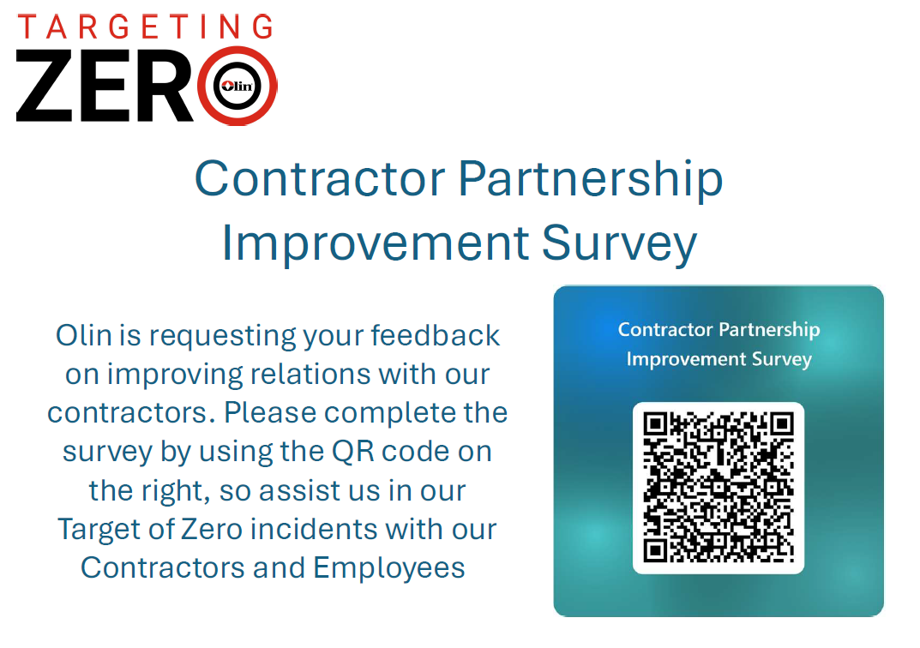
Survey

